Slide 1
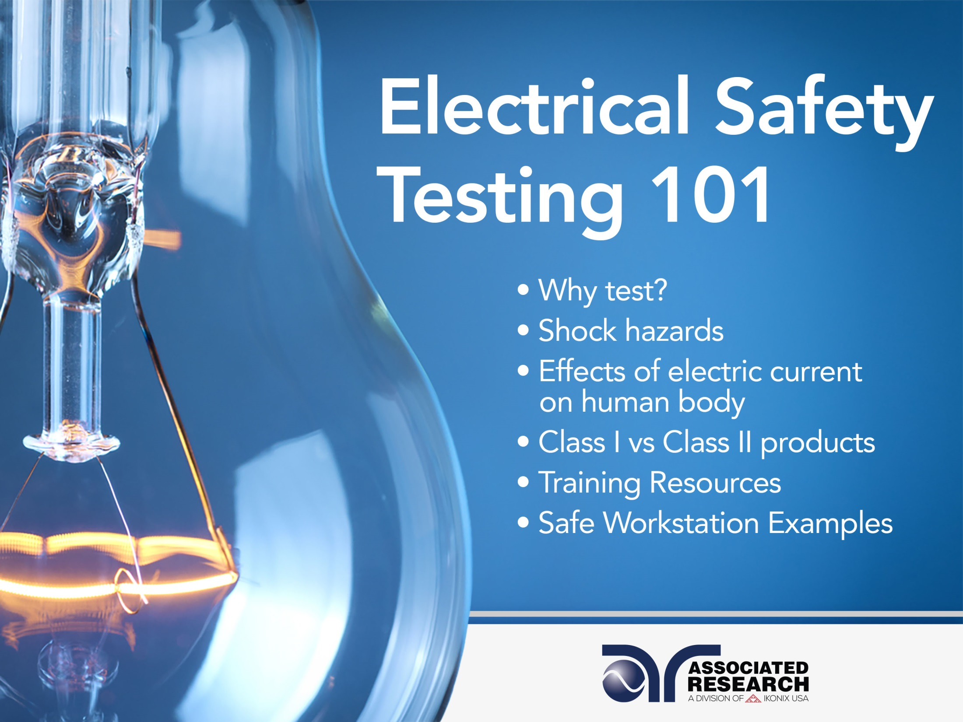

Slide 2


Slide 3
Webinar Notes
Please use the Q & A utility to ask us any questions concerning the material being presented.
Any questions related to running of the meeting (audio and visual, etc.) can be addressed to the host, Allison Oba, through the chat line.
The webinar is being recorded and will be available to view usually within a day on our website www.arisafety.com/webinars
Please contact Allison Oba – on the chat line or email allison.oba@arisafety.com if you would like a copy of this presentation.

Slide 4
Learning Objectives
SAFETY
Safe Work Stations
Potential Shock Hazards
TESTING
Why Test?
Insulation Types: Class I Vs. Class II
TESTING RESOURCES
OSHA, NEC
EN 50191
Presentation Objectives
Recognize an electrical safety hazard • Setup a safe testing work station
Find resources for operator training

Slide 5
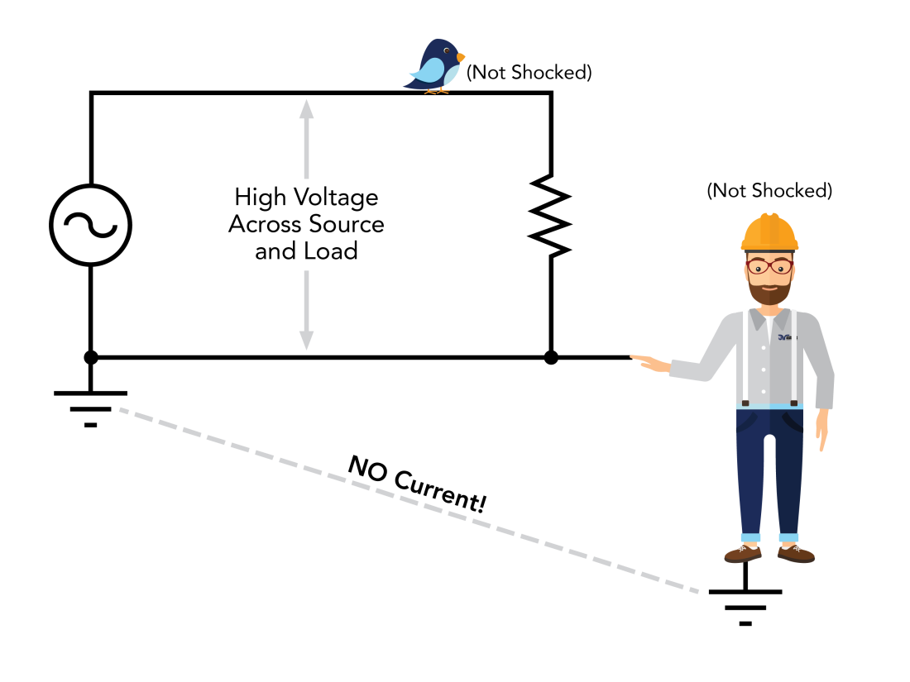
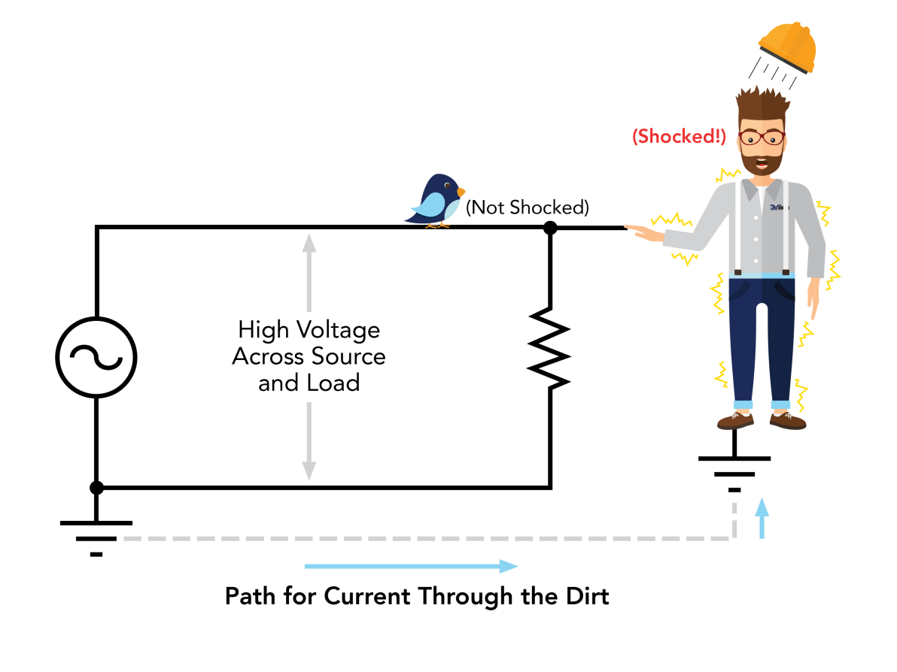
Potential Shock Hazards
Contact with the “Low” side of Voltage places Operator at same Potential as ground therefore there is no Potential difference or Voltage to allow current to flow through him.
Contact with the “High” side of Voltage while standing on ground allows a path for current to return to ground through the Operator

Slide 6
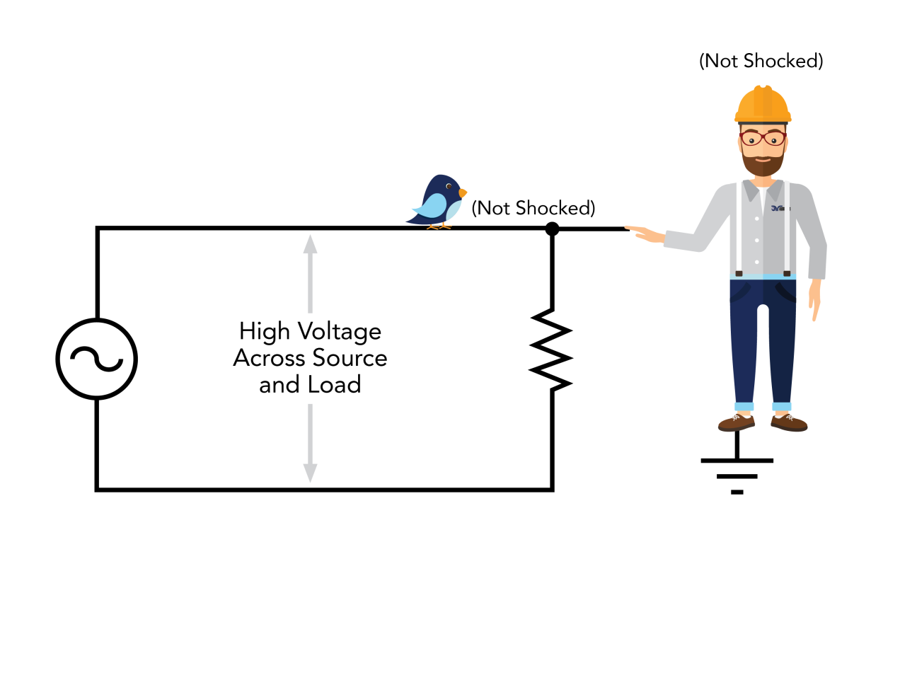
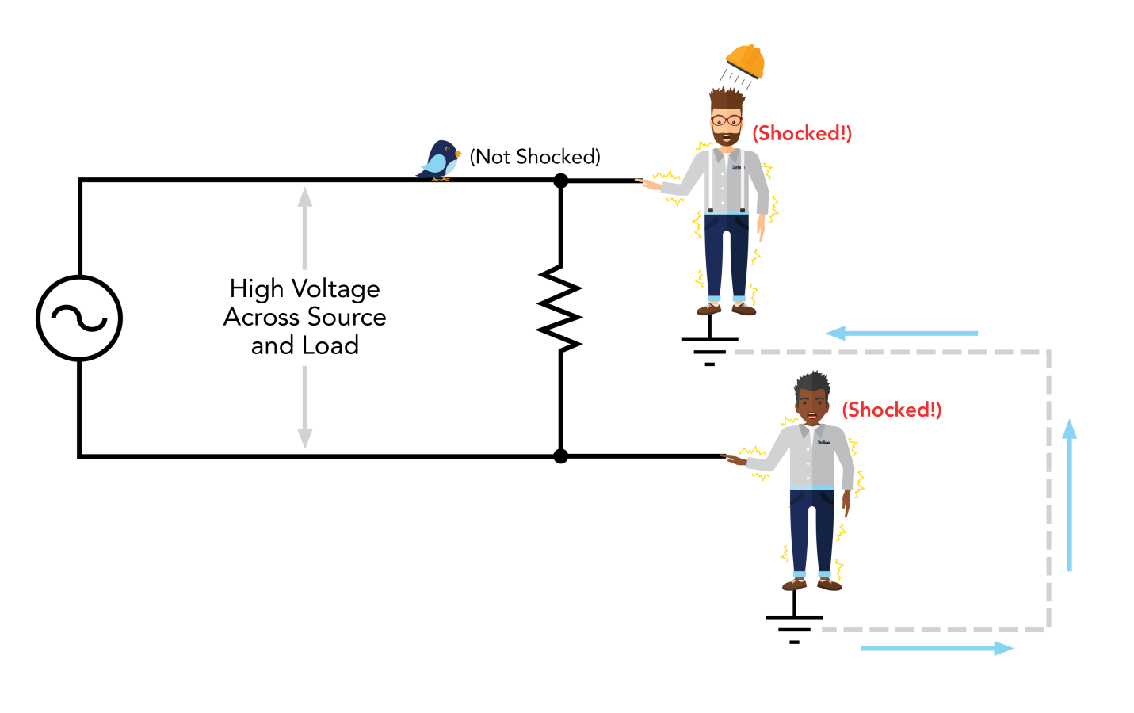
An isolated source in theory is safe. Since the low side of the transformer is not referenced to ground, making contact with any point of the circuit while standing on ground does not allow current a path back to the source.
The danger with an un-grounded power source is the possibility of accidental grounding or contact made with two points of the circuit.

Slide 7
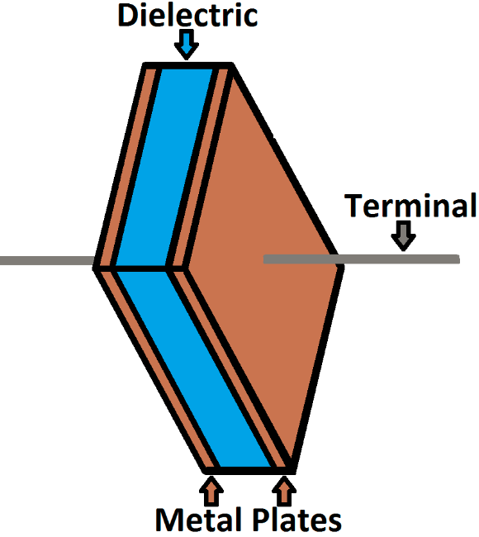
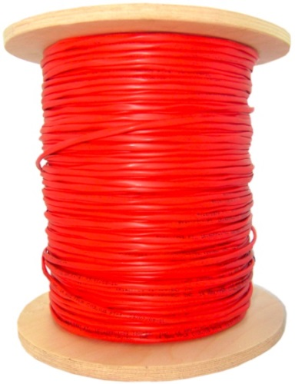
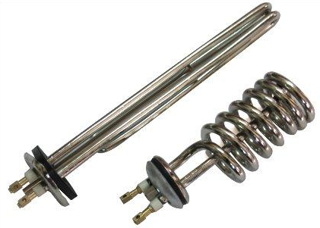
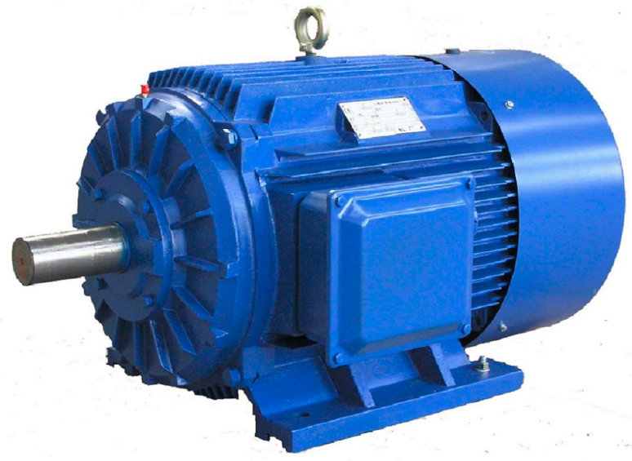
Understanding the Dangers of Capacitive Charge
Capacitors consist of conducting surfaces separated dielectric (insulator). The effect of this is that when a voltage is applied, charge flows into the capacitor and is stored. When an external circuit is connected to the capacitor, this stored charge will flow from the capacitor into the circuit.
Unintended capacitors can cause potential shock hazards

Slide 8
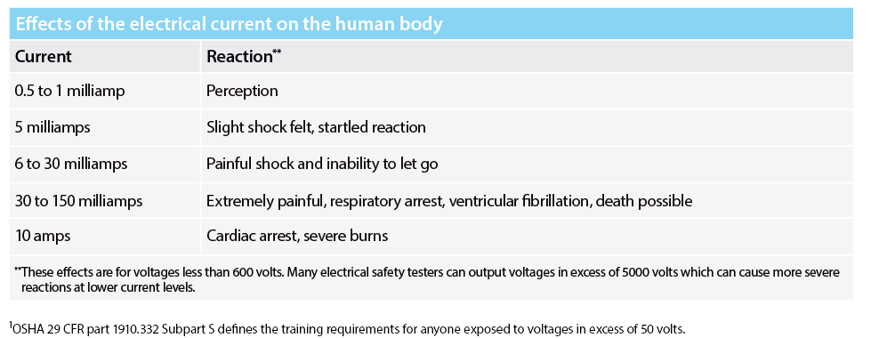
Effects of Electrical Current
The effects of current can vary drastically due to a number of variables. It’s important to be mindful to the shock hazards to which you could be exposed. For example, the 3705 hipot tester has the capability to output 20mA of AC current.

Slide 9
Severity of Electrical Shock
The severity of shock is received by a person who contacts an electrical circuit is influenced by several factors:
Physical condition and response.
The path of the electrical current through the body.
The duration or length of time the person is exposed.
The magnitude of the voltage and current flow.
The frequency of the supply voltage.
4 Main types of Electrical injuries:
Electrocution (fatal) • Electric shock • Burns
Falls caused as a result of contact with electrical energy

Slide 10
Human Body Resistance
The human body on an average has about 1000 to 1500 ohms resistance.
The outer layer of the skin provides the largest percentage of the body’s electrical resistance.
The parts of the body which conduct the electricity the best are the blood vessels and nerves.

Slide 11

The current required to light a 7 watt, 120V lamp, passed across the chest is enough to cause fatality.
I = 120V/1,000 Ohms = 0.120A

Slide 12
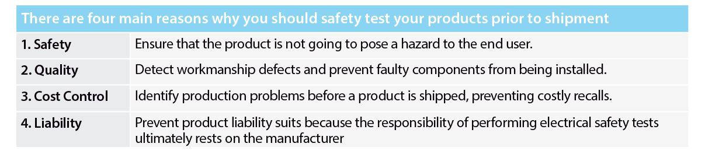
Why Test?
Testing also comes down to risk analysis. Safety standards call for production hipot and continuity testing. However, there has been a shift in recent years towards more stringent production line testing.

Slide 13

Testing Laboratories
Create standards that outline performance and production testing.
Implement and enforce electrical safety testing to protect users from potential electric shock.
NRTL Examples Underwriters Laboratories (UL – United States), TUV Rheinland (Germany), Canadian Standards Association (CSA – Canada), ETL (Intertek – United States) and CCC (China Compulsory Certification – China)

Slide 14
Poll Question
Has your Company had an employee incident involving electric shock in the past year?

Slide 15
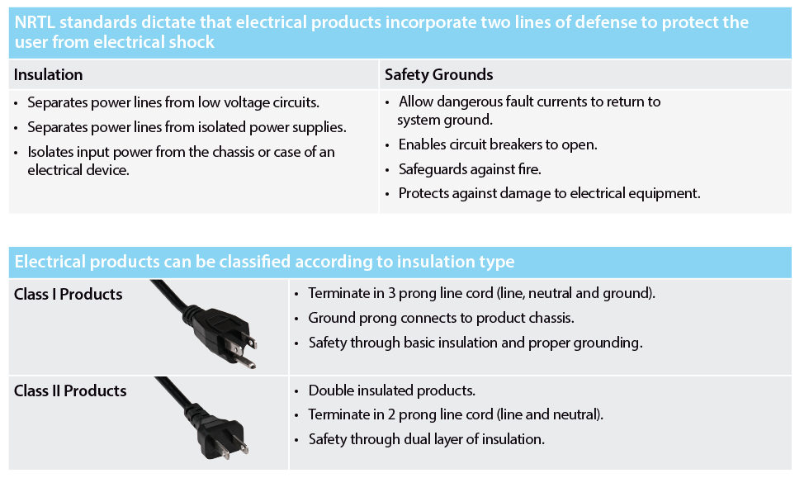

Slide 16

Electrical Accidents in the Workplace
Most electrical accidents in the workplace are a direct result from one of the following three factors:
Unsafe equipment or installation
Unsafe
Environment
Unsafe Work
Practices
These accidents can be prevented through the use of insulation, guarding, grounding, electrical protective devices and safe work practices.

Slide 17
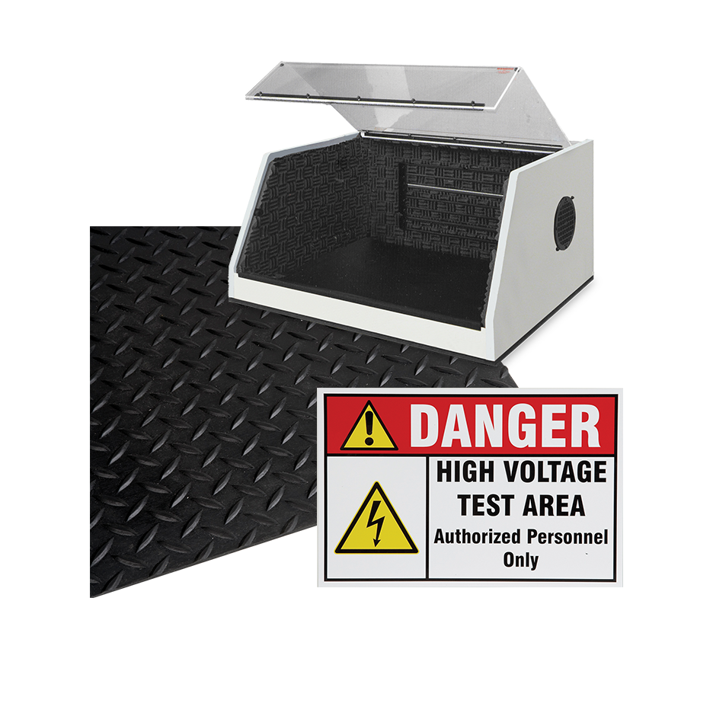
How to Create a Safe Work Area
Operator Training
Understanding Voltage and Current
Identifying potential shock hazards
Utilizing Safety Devices
DUT Enclosures, Signal Tower lights, Insulation Mats, etc.
It’s the responsibility of the employer to ensure safe working conditions and safe working environments for all test operators.

Slide 18
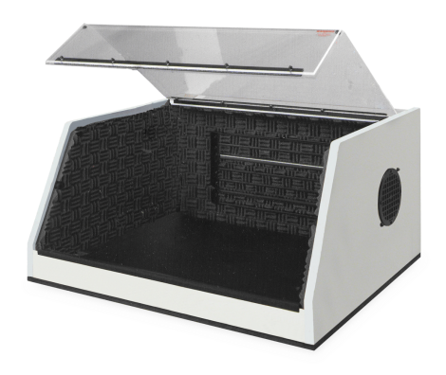
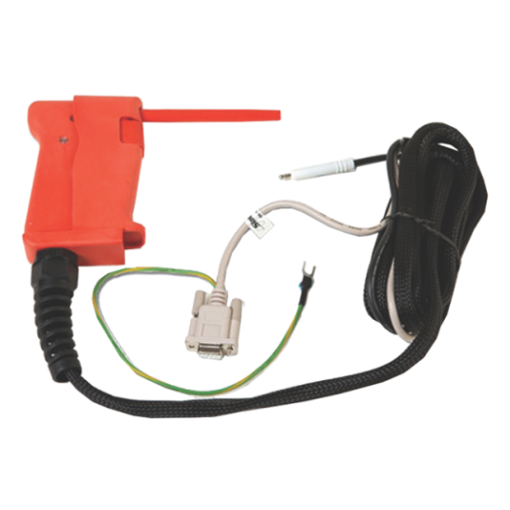
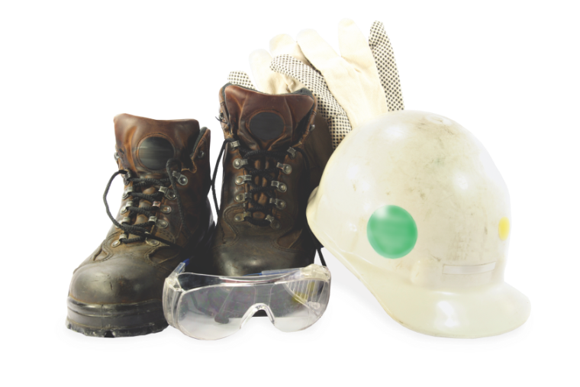
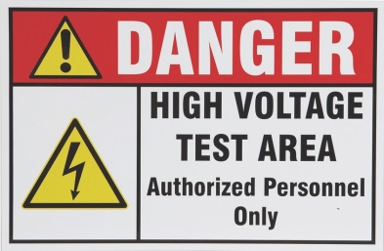
How to Create a Safe Work Station
Enclosure designed to remove shock hazard
Cabling and insulation
Use PPE (Personal Protective Equipment)
Be aware of all nearby hazards

Slide 19
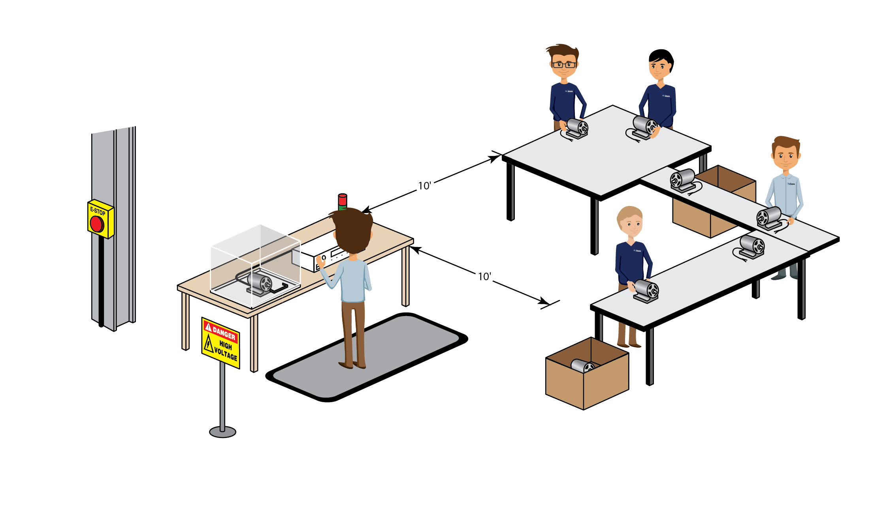
Methods of Safety Testing
Testing Station with Positive Protection

Slide 20
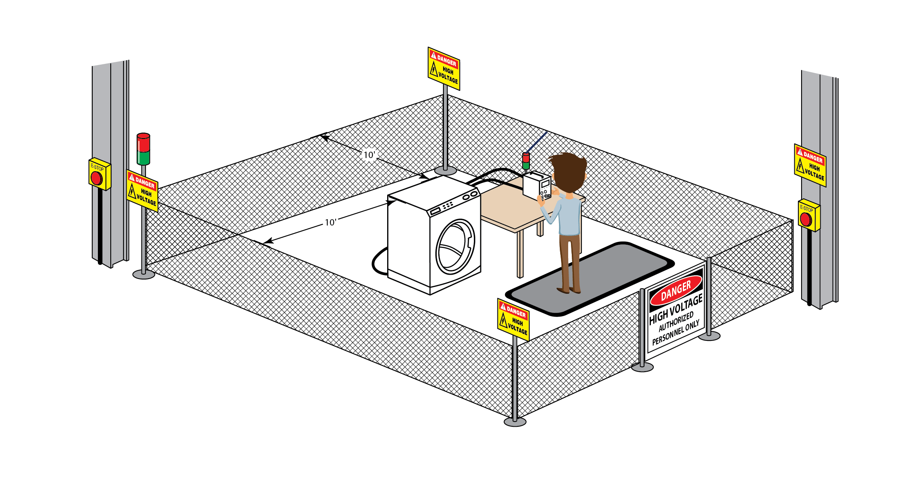
Methods of Safety Testing
Testing Station with NO Positive Protection

Slide 21
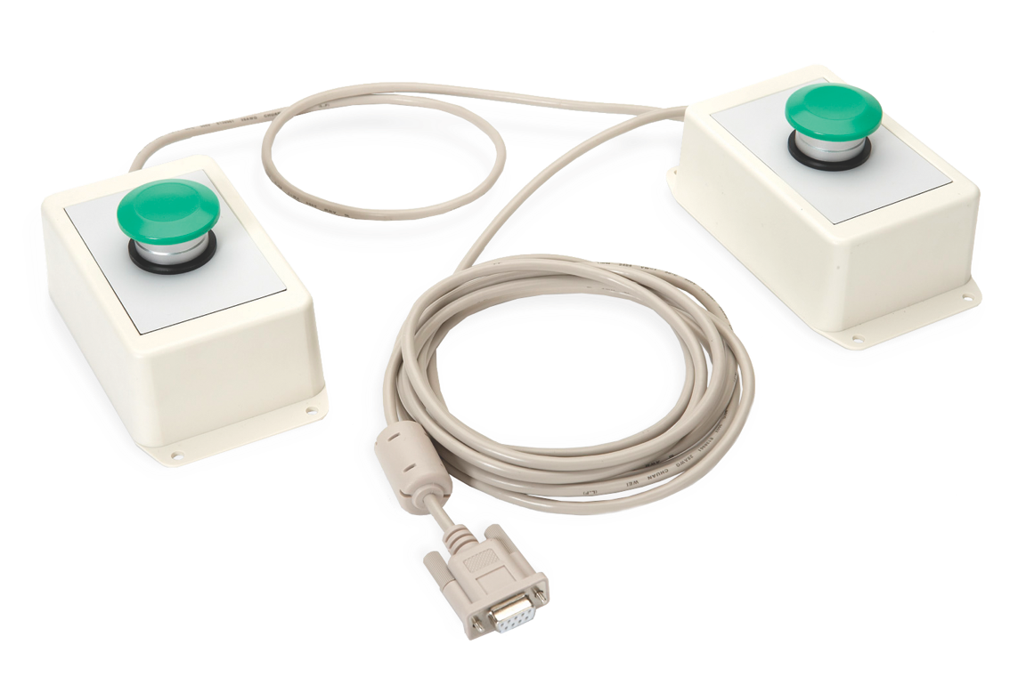
Additional Methods for Operator Safety
SAFETY FIRST!
This does not allow the operator to touch the DUT as their hands must remain on the test switches during the test.
Dual Palm Remote Switches
Simultaneous Activation
Activation of both within 0.5 sec

Slide 22
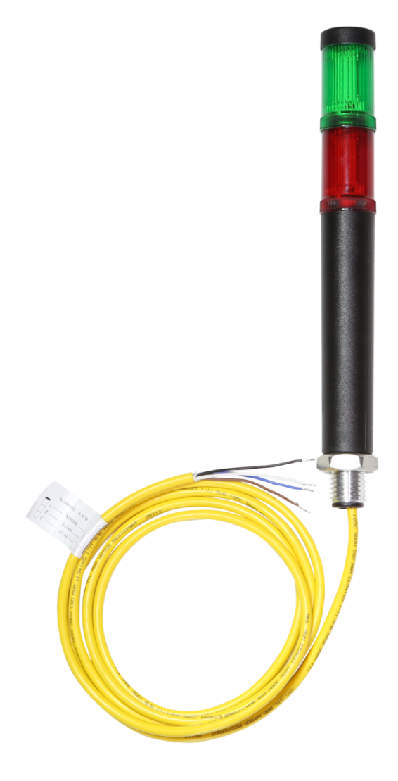
Additional Methods for Operator Safety
SAFETY FIRST!
Mounted lights warn operators in the nearby area to the status of the Hipot test and if the instrument is outputting high voltage.
Signal Lights
Illuminates red when test is active.
Mounted in plain site for entire work area.

Slide 23
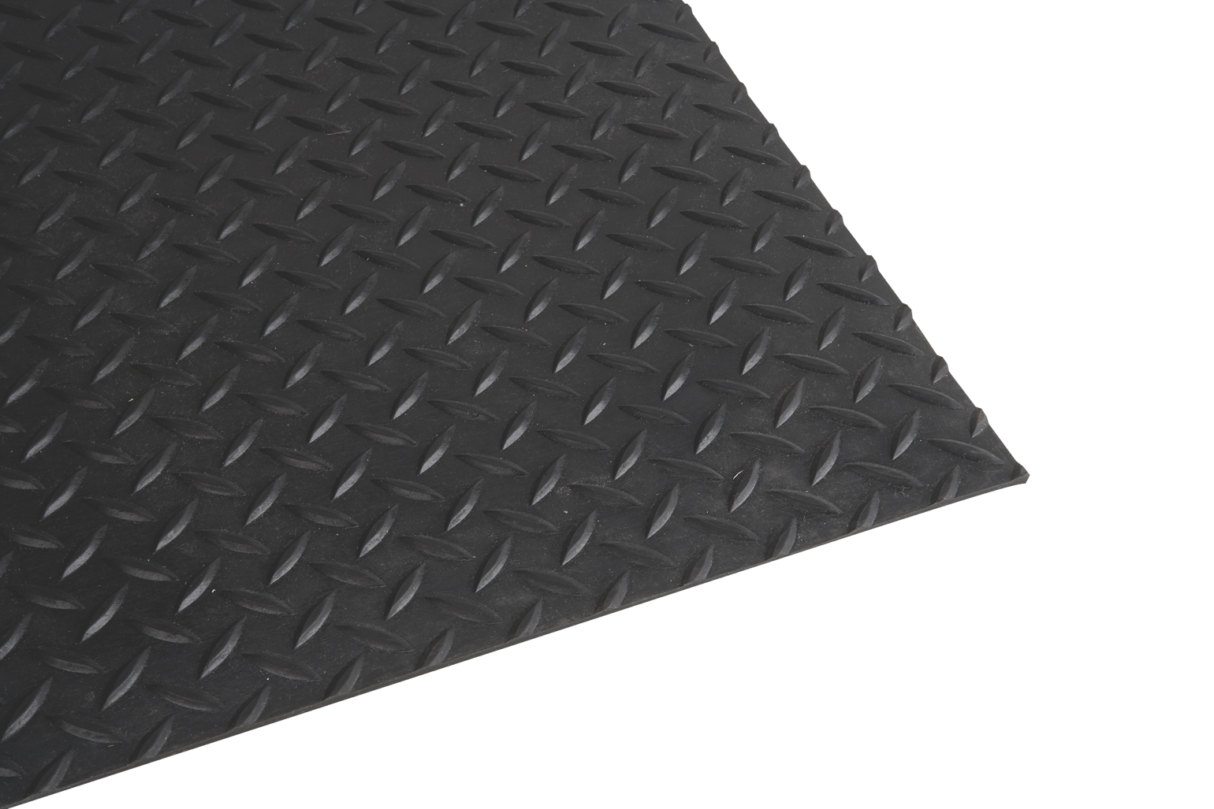
Additional Methods for Operator Safety
SAFETY FIRST!
The mat isolates the operator from ground while testing which greatly mitigates the shock hazard.
Insulation Mat
Isolates user from ground potential

Slide 24
Poll Question
What safeguards are you currently using in your workstation?

Slide 25

Demonstration

Slide 26
Training Resources
OSHA 29 CFR part 1910.332 Subpart S
Defines the training requirements for anyone exposed to voltages in excess of 50 volts
Employees must be qualified to work on or near exposed energized parts
NFPA 70E: Standard for Electrical Safety in the Workplace 2012
Explains reason behind the rule and how to comply
Safe work practices, PPE and lockout/tagout procedures
BS EN 50191:2010
Erection and Operation of Electrical Test Equipment
Defines recommended setups for electrical testing stations

Slide 27


Resources
Visit us online to view all of our Educational Resources:
http://www.arisafety.com/support/educational-resources/

Slide 28

Contact Us
If you would like a copy of this presentation please email Allison Oba at allison.oba@arisafety.com
Check out our website for more information arisafety.com

